Slide 1
MULTI-CUT-OFF REBAR
Advisor : Prof. K.C.Chang
Presenters : You-Ran Nai
Notes:
Try 講清楚脈絡

Slide 2
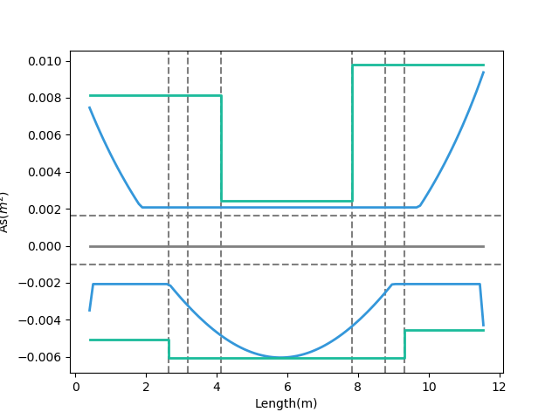
Max
Max
Design As
Today’s Solution
Fixed Bar-Cut
Max
Demand As
Notes:
LowSeismic4Floor12M 0

Slide 3
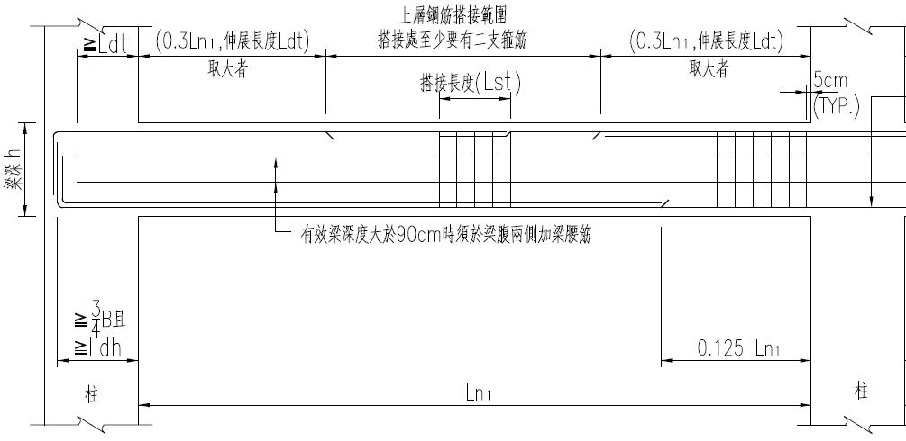
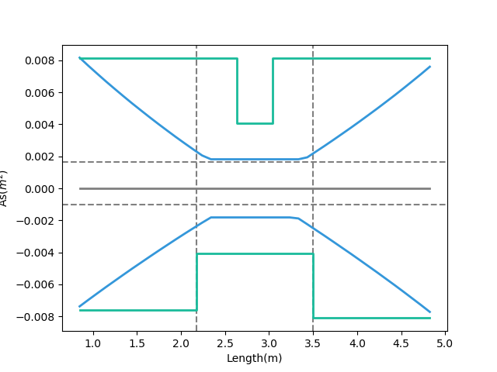
大梁鋼筋配置標準圖
Tradition
Design As
Demand As
Notes:
欣銓 1140

Slide 4
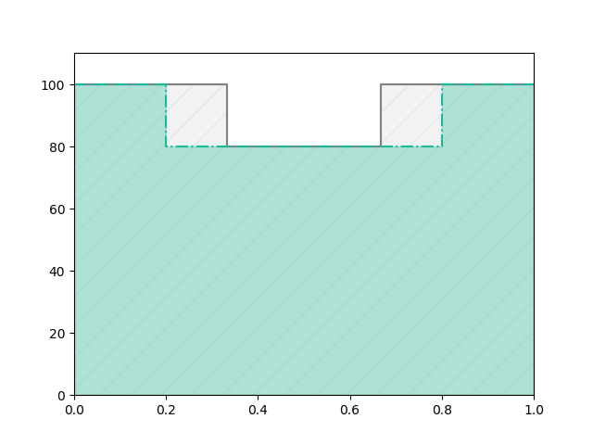
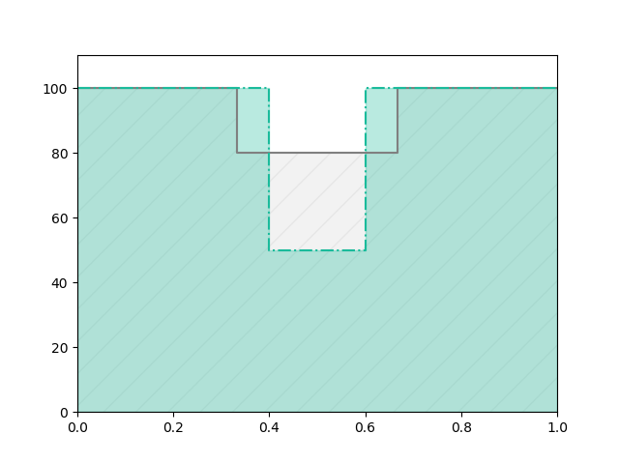
Before
After
REDUCE REBAR
Before
Real
Demand
After

Slide 5
Outline
Part 2
Part 4
Shear Reinforcement
Nonlinear Verification
Part 1
Part 3
Flexural Reinforcement
Condition

Slide 6
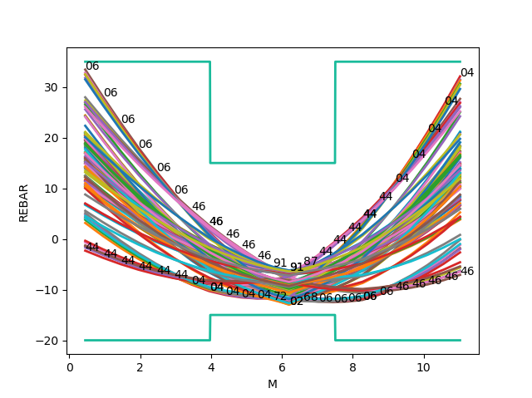
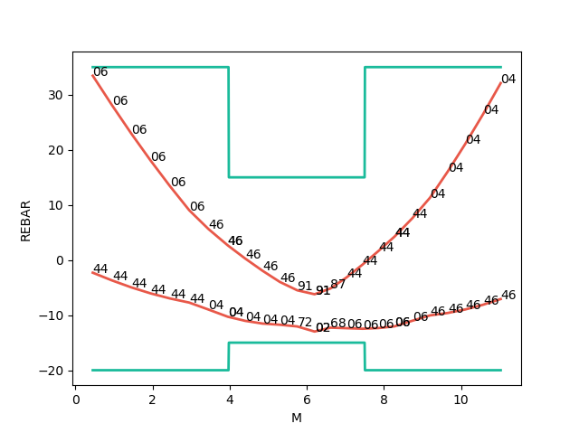
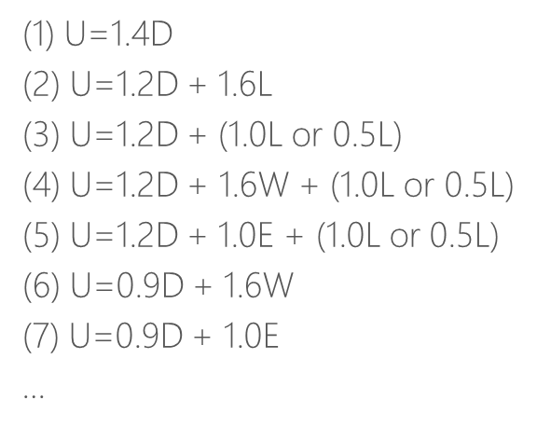
Mu
Consider Hundreds Of Combo Demand
Catch Critical Demand Combo

Slide 7
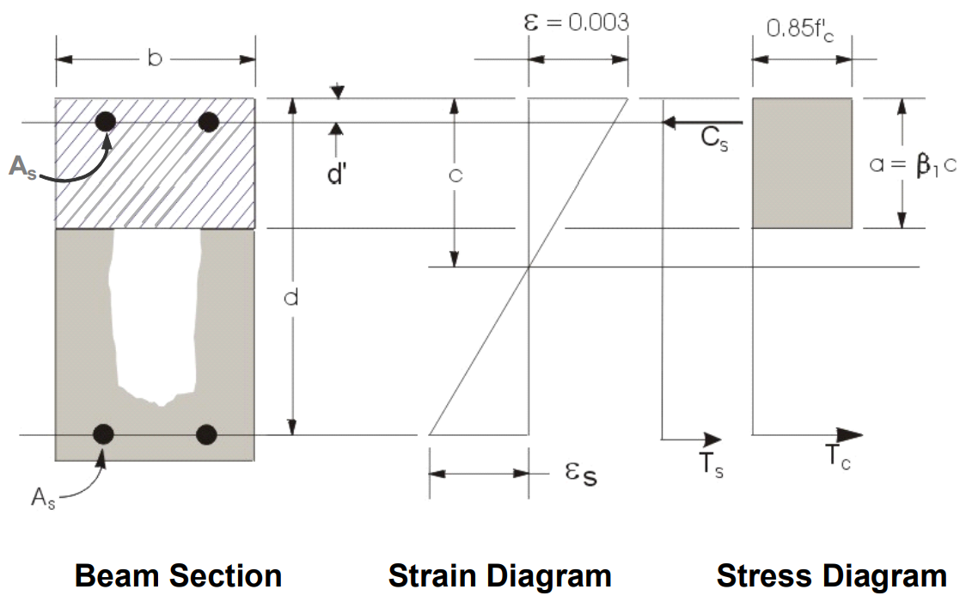
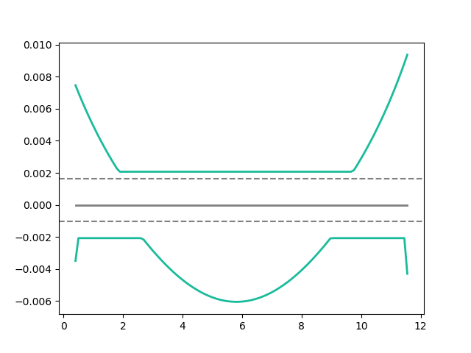
Flexural Reinforcement
Area of flexural reinforcement
Min: 2 Rebar

Slide 8
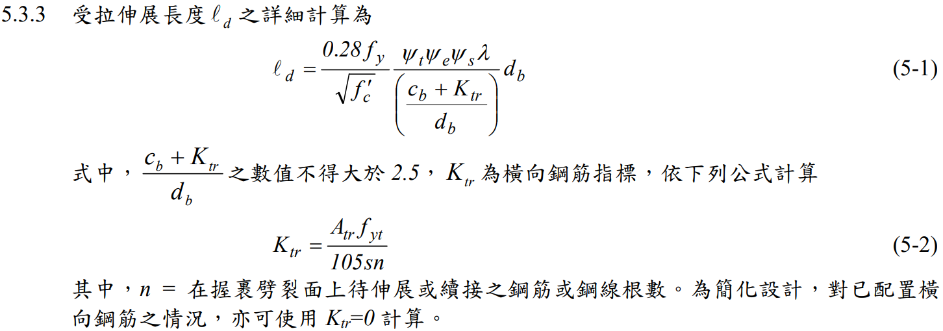
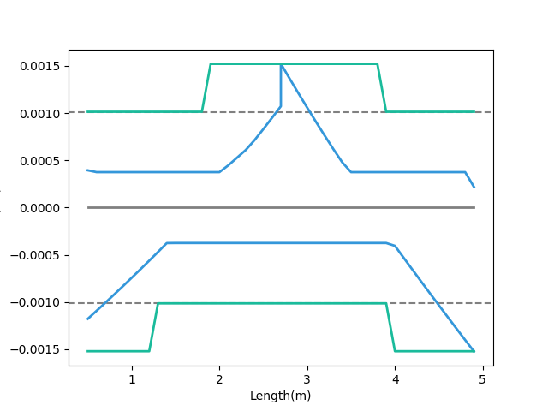
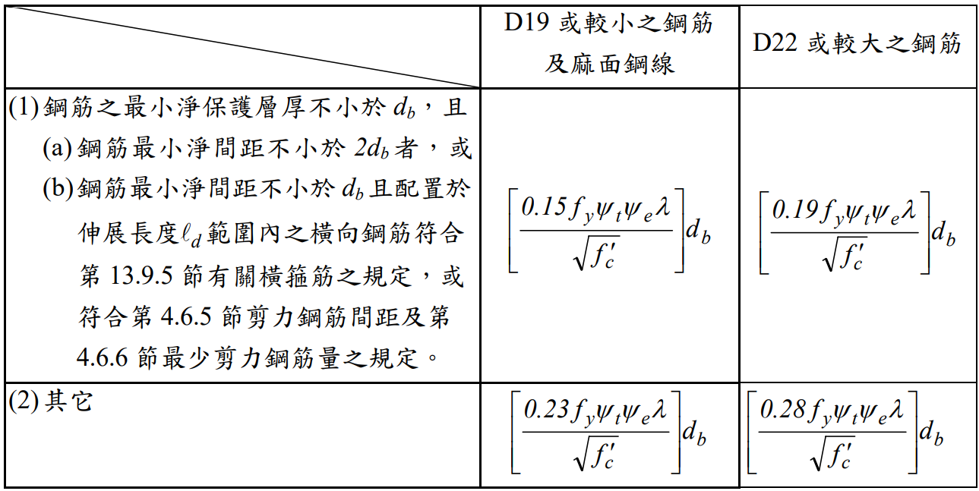
General Development Length Equation
Development Length
Demand As
MIN
Simplified Provisions
Add Ld As
Notes:
欣銓 1228

Slide 9
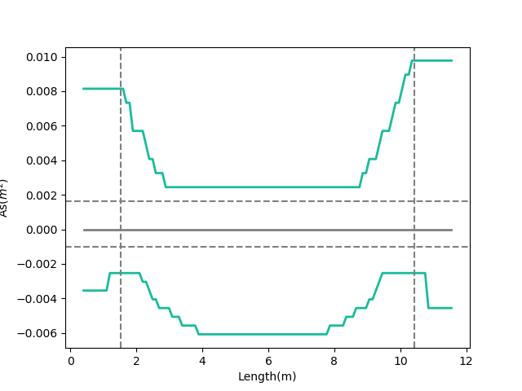
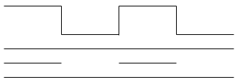
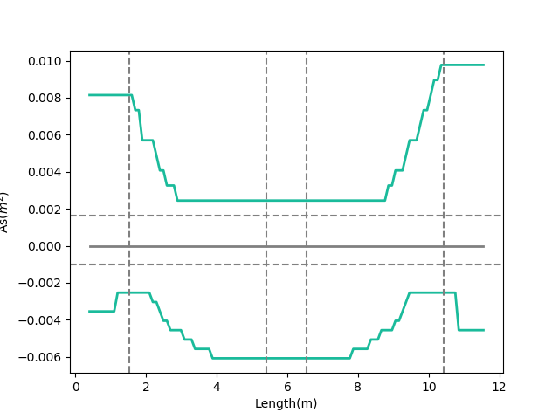
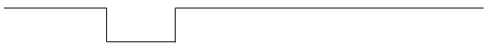
Combinations
As
多點
0.1
Ln
0.9
Ln
漸進式退縮
三段
0.1
0.45
0.55
0.9
Notes:
GA 演算法
LowSeismic 4Floor 12M 0

Slide 10
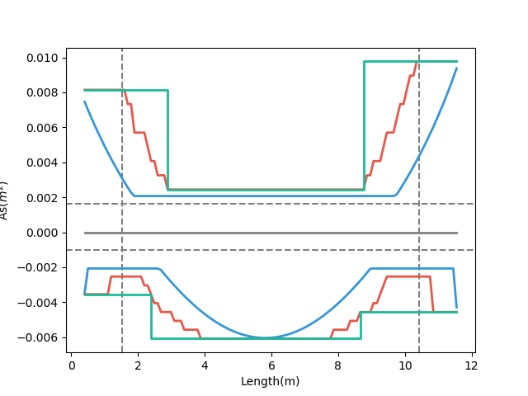
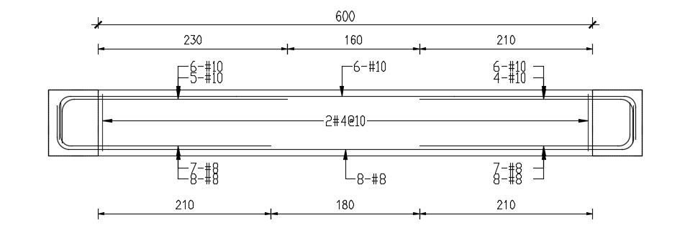
Development Length
梁撓曲鋼筋配置示意圖
Design As
Demand As
Notes:
LowSeismic 4Floor 12M 0

Slide 11
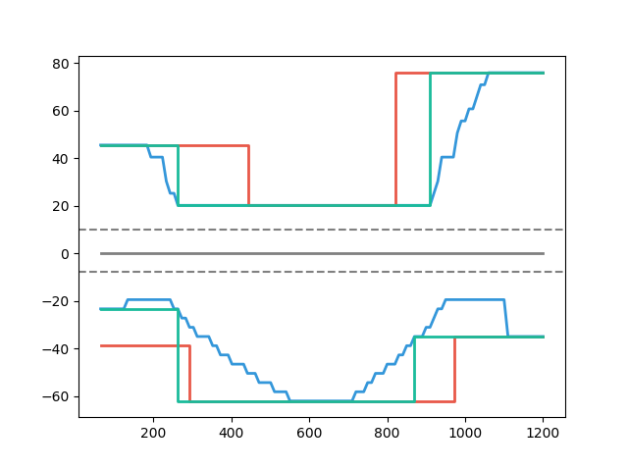
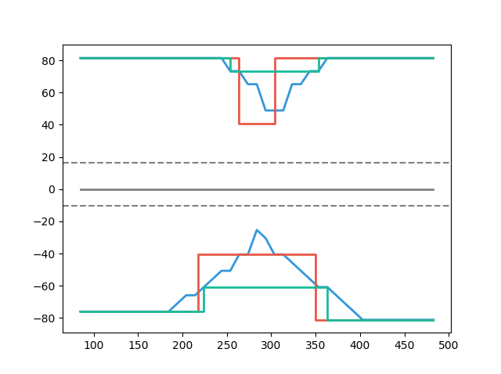
Case Study
Multi-Cut 82%
Tradition
Multi-Cut
Tradition
Development Length
Development Length
Multi-Cut 91%
Length(cm)
Notes:
傳統不經濟
828
傳統不保守 不符合 混凝土結構設計規範 401-100 R5.11.2
1140

Slide 12
Outline
Part 2
Part 4
Shear Reinforcement
Nonlinear Verification
Part 1
Part 3
Flexural Reinforcement
Condition

Slide 13


Slide 14
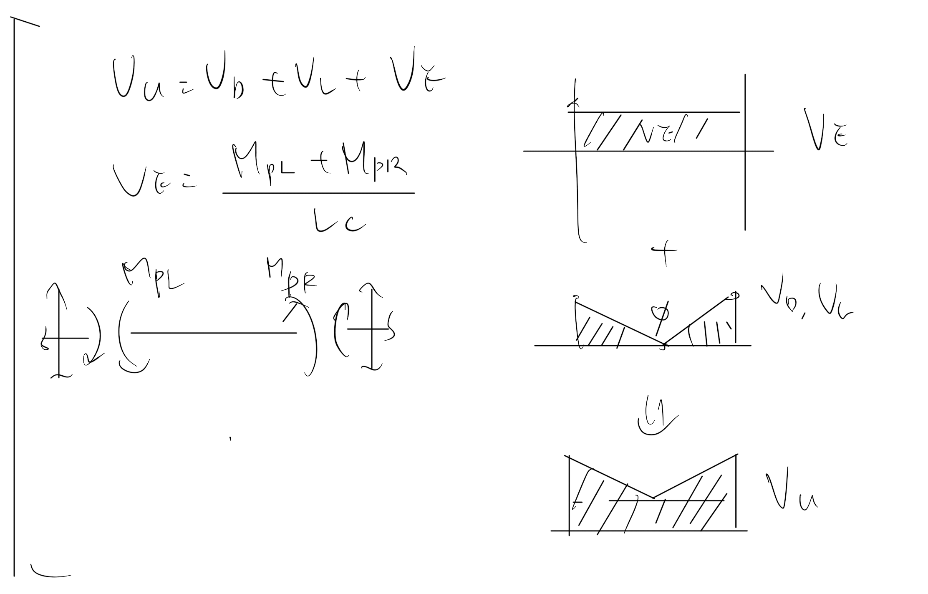
Vu
Notes:
LowSeismic4Floor12M 0

Slide 15
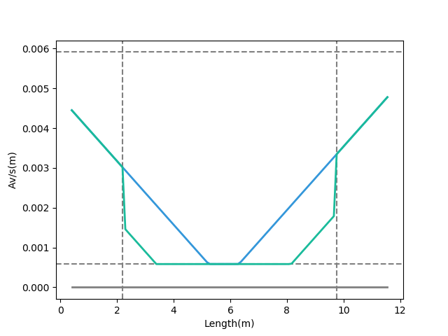
Shear Reinforcement
Vu
Notes:
LowSeismic4Floor12M 0

Slide 16
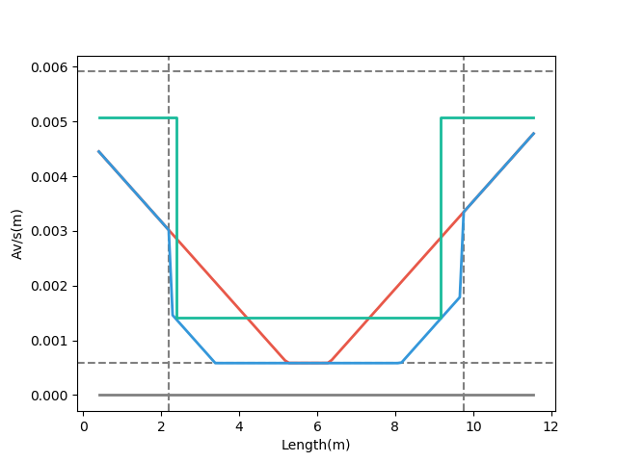
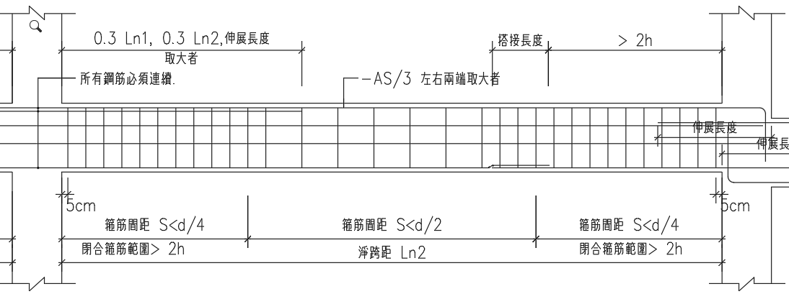
梁剪力鋼筋配置示意圖
Design Av
Demand Av
Consider Vc Demand
Notes:
LowSeismic4Floor12M 0

Slide 17
Outline
Part 2
Part 4
Shear Reinforcement
Nonlinear Verification
Part 1
Part 3
Flexural Reinforcement
Condition

Slide 18
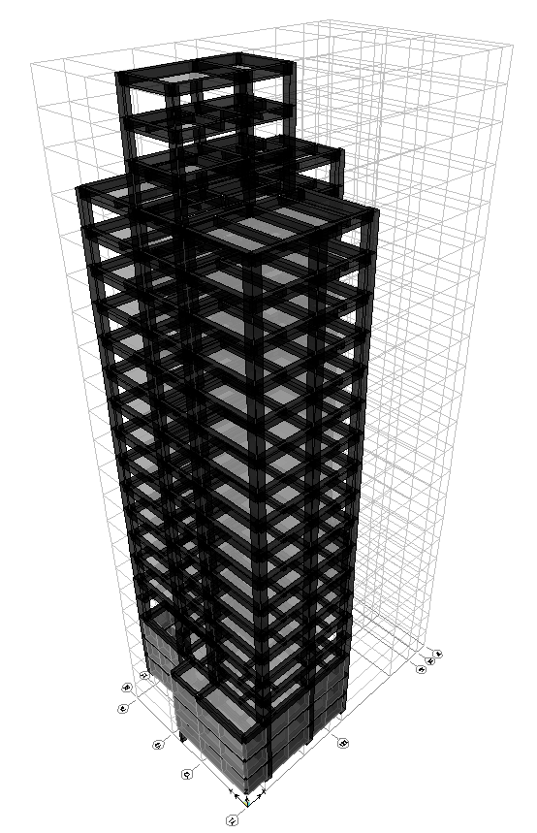
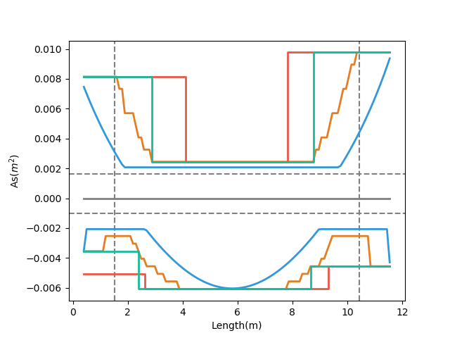
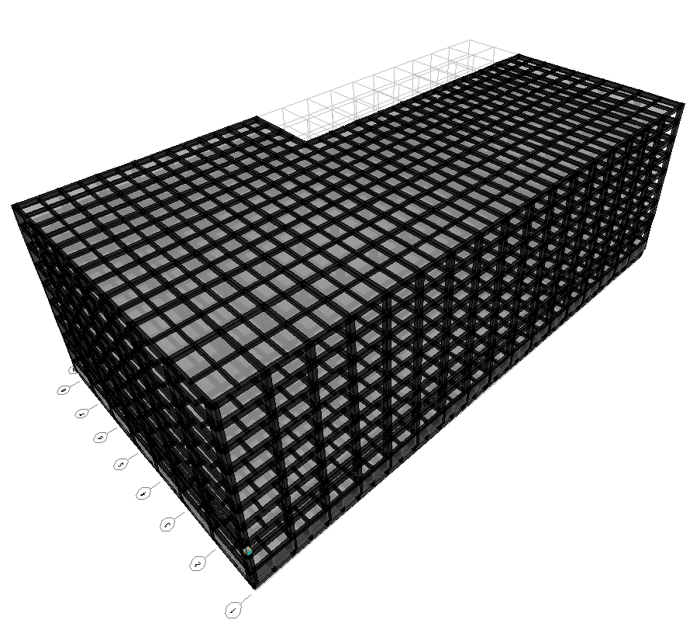
台北住宅案
Multi-Cut As
Tradition As
Demand As
Development Length
高雄物流中心
Notes:
LowSeismic4Floor12M 0

Slide 19
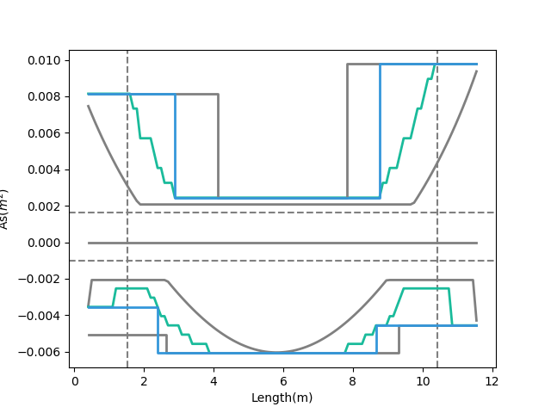
Development Length
Multi-Cut As
Short Development Length
Tradition As
Beam Length
Demand As
Notes:
LowSeismic4Floor12M 0

Slide 20
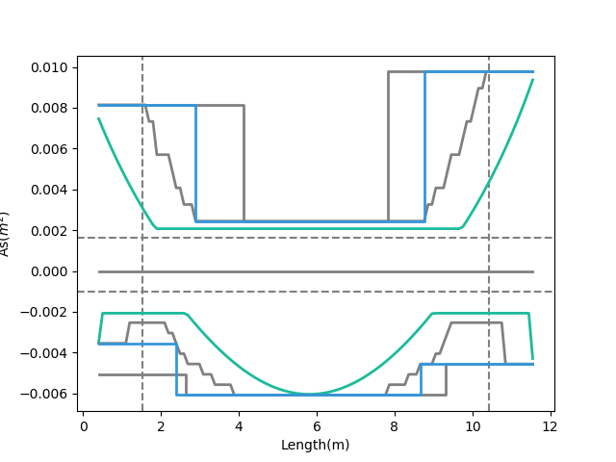
Multi-Cut As
Tradition As
Moment Decay
Demand As
Notes:
LowSeismic4Floor12M 0

Slide 21
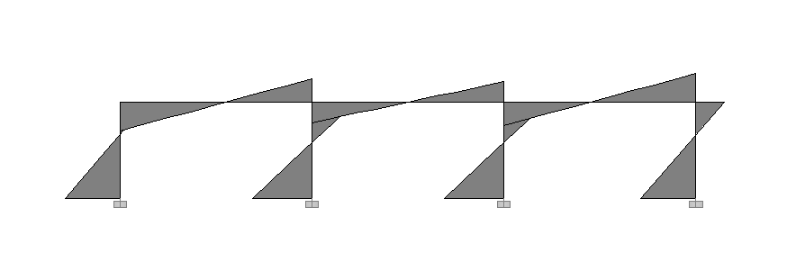
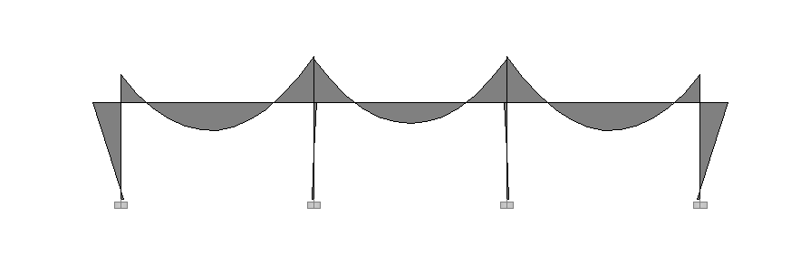
Seismic Load
Lateral
Force
Moment Diagram
Gravity Load
Gravity Load

Slide 22
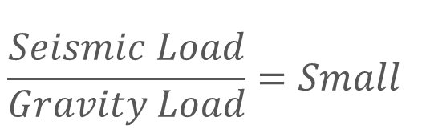
Lateral
Force
Moment Decay
$$\frac{Seismic Load}{Gravity Load}=Small$$
Gravity Load
Beam Length

Slide 23
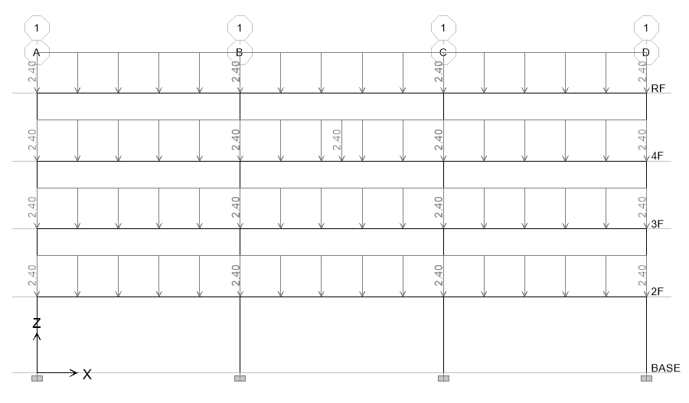
11 Models
Notes:
LowSeismic4Floor12M 0

Slide 24
整體優化結果
6m
9m
12m
Low Seismic
98.1%
94.5%
90.4%
Middle Seismic
99.6%
95.3%
93.6%
High Seismic
100.6%
94.2%
94.8%

Slide 25
整體優化結果
6m
9m
12m
Low Seismic
98.1%
94.5%
90.4%
Middle Seismic
99.6%
95.3%
93.6%
High Seismic
100.6%
94.2%
94.8%

Slide 26
上層筋優化結果
6m
9m
12m
Low Seismic
99.5%
91.2%
86.0%
Middle Seismic
104.4%
96.0%
91.2%
High Seismic
103.4%
97.4%
94.9%

Slide 27
上層筋優化結果
6m
9m
12m
Low Seismic
99.5%
91.2%
86.0%
Middle Seismic
104.4%
96.0%
91.2%
High Seismic
103.4%
97.4%
94.9%

Slide 28
下層筋優化結果
6m
9m
12m
Low Seismic
96.0%
99.4%
96.5%
Middle Seismic
91.9%
94.3%
97.2%
High Seismic
96.1%
89.0%
94.6%

Slide 29
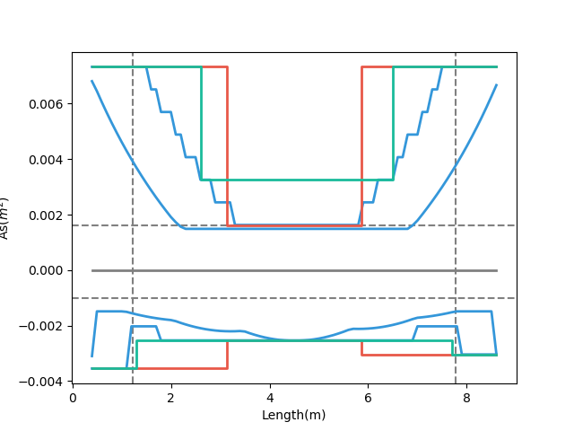
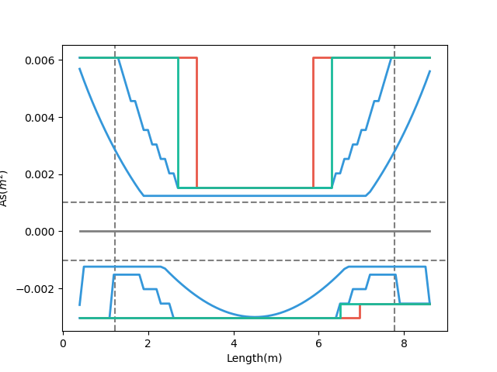
Why?
High Seismic
Low Seismic
Smaller
Bigger
89%
99%

Slide 30
箍筋優化結果
6m
9m
12m
Low Seismic
93.3%
94.1%
94.5%
Middle Seismic
96.6%
94.4%
93.9%
High Seismic
98.5%
92.0%
93.2%

Slide 31
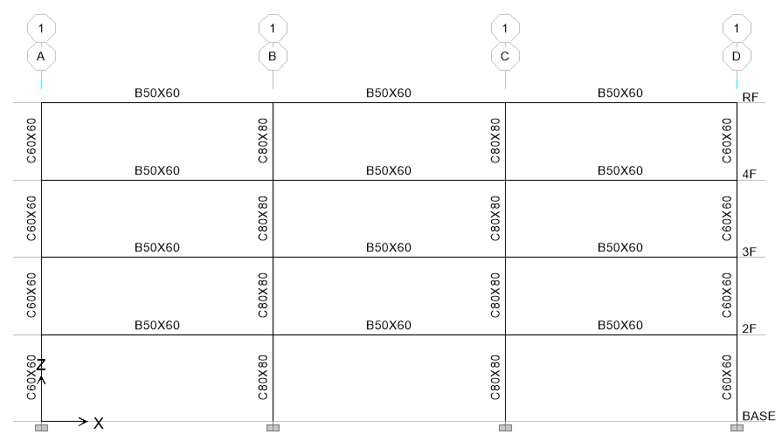
More Cut-Off
3
4
5
6
Unlimited
Notes:
理論最佳解

Slide 32
More Cut-Off
3
4
5
6
Unlimited
Notes:
理論最佳解

Slide 33
台北住宅案
100.1%
OVERALL RESULT
14F B3
101.3%
TOP RESULT
98.5%
BOT RESULT
20m
30m
Notes:
由於很複雜，先記得最終的結果
400

Slide 35
9F B1
93.4%
OVERALL RESULT
92.3%
TOP RESULT
153m
77m
94.7%
BOT RESULT
高雄物流中心
Notes:
3500

Slide 37
Cost Analysis
Reduced Percentage
Material Reduced Cost
$$Δ=−\frac{60kg}{m^{2}}∗2\%∗\frac{\$28}{kg}=−\$33.6/m^{2}$$
Girder Used
Material Cost

Slide 38
Cost Analysis
Increase
Construction Cost
Reduced
Material Cost
$$Δ=\frac{\$100}{t}∗\frac{0.15t}{m^{2}}−\frac{60kg}{m^{2}}∗2\%∗\frac{\$28}{kg}=−\$18.6/m^{2}$$
$$Δ=\frac{\$200}{t}∗\frac{0.15t}{m^{2}}−\frac{60kg}{m^{2}}∗2\%∗\frac{\$28}{kg}=−\$3.6/m^{2}$$
Increase Wage

Slide 39
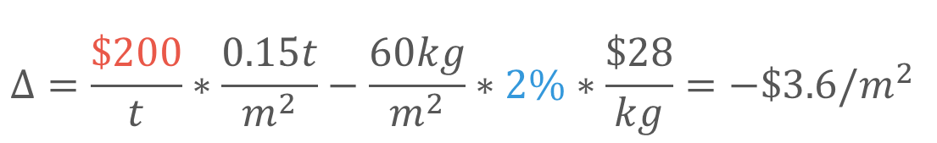
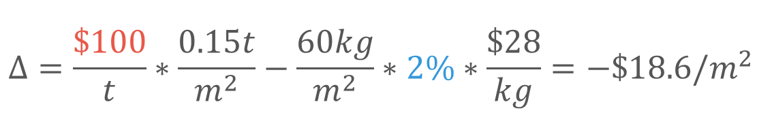
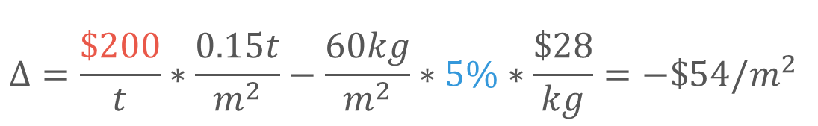
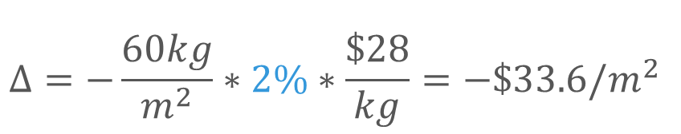
Cost Analysis
$$Δ=−\frac{60kg}{m^{2}}∗2\%∗\frac{\$28}{kg}=−\$33.6/m^{2}$$
$$Δ=\frac{\$100}{t}∗\frac{0.15t}{m^{2}}−\frac{60kg}{m^{2}}∗2\%∗\frac{\$28}{kg}=−\$18.6/m^{2}$$
$$Δ=\frac{\$200}{t}∗\frac{0.15t}{m^{2}}−\frac{60kg}{m^{2}}∗2\%∗\frac{\$28}{kg}=−\$3.6/m^{2}$$
$$Δ=\frac{\$200}{t}∗\frac{0.15t}{m^{2}}−\frac{60kg}{m^{2}}∗5\%∗\frac{\$28}{kg}=−\$54/m^{2}$$

Slide 40
Outline
Part 2
Part 4
Shear Reinforcement
Nonlinear Verification
Part 1
Part 3
Flexural Reinforcement
Condition

Slide 41
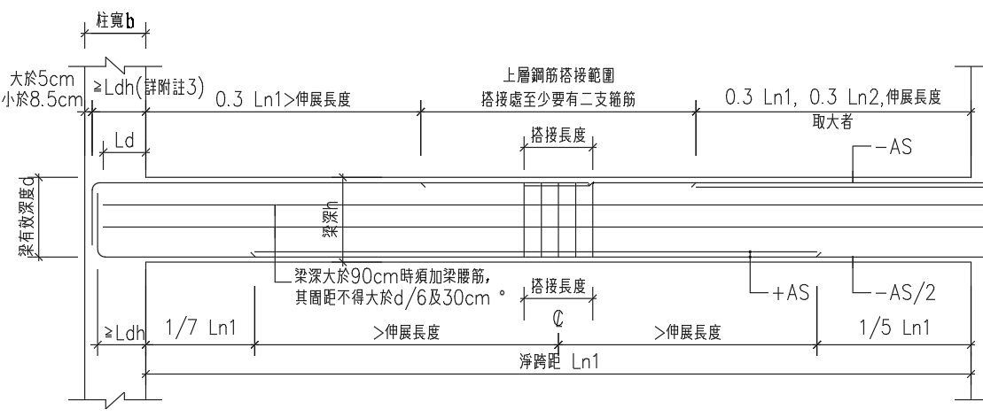
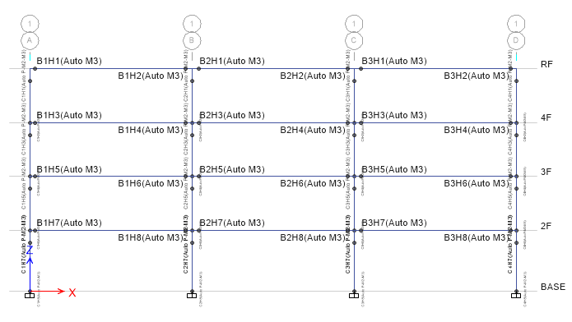
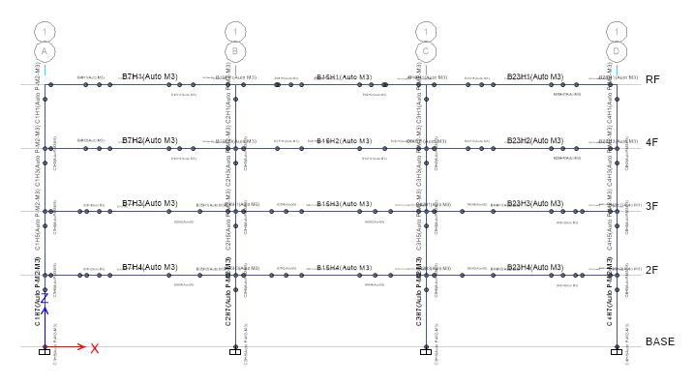
Consider Ld

Slide 42
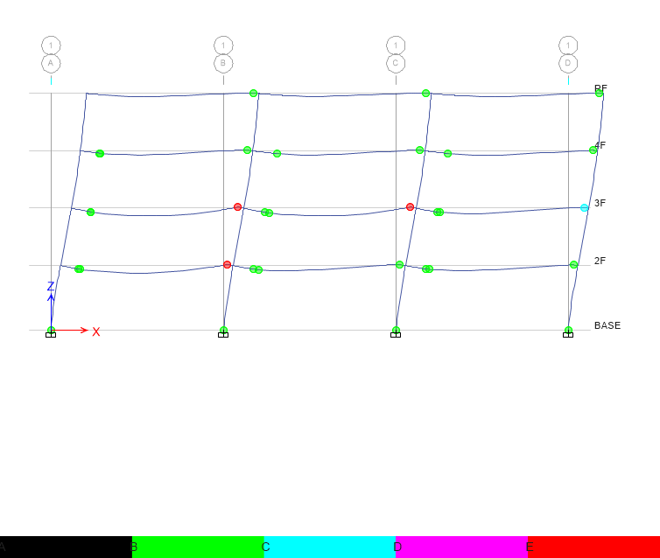
Hinge
Third Hinge
+

Slide 43
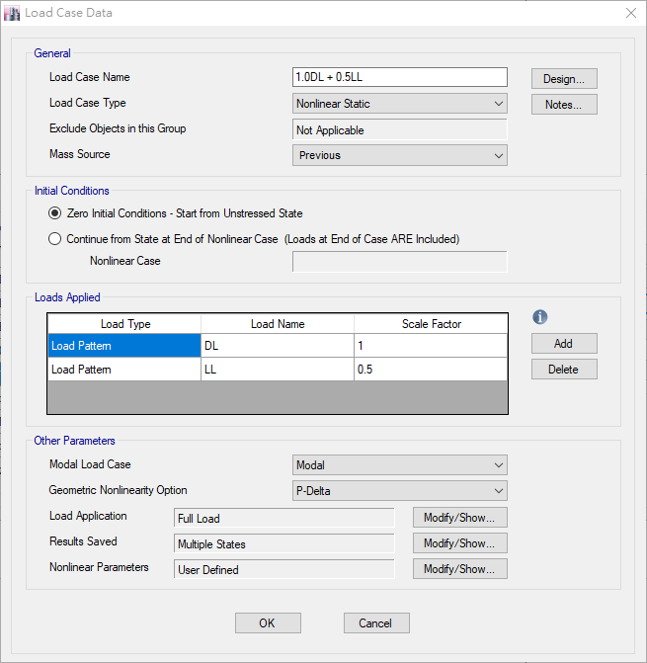
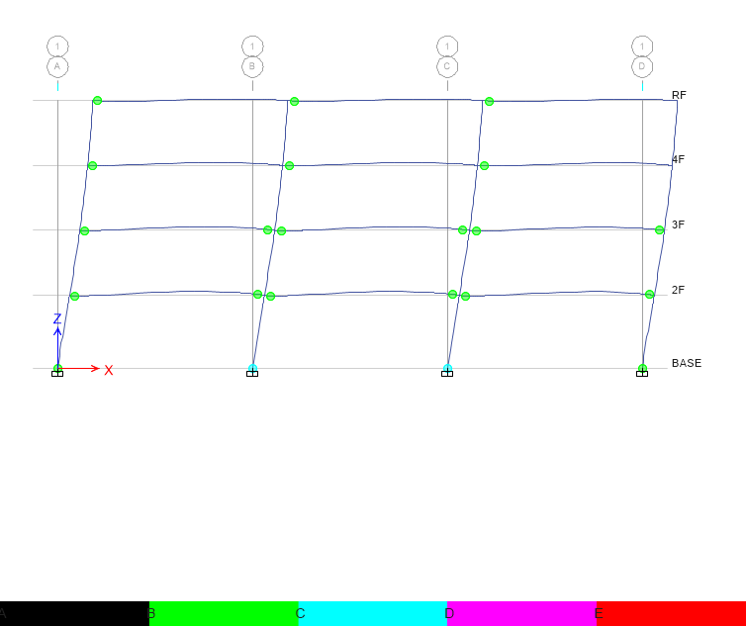
Hinge
Without Initial Conditions

Slide 44
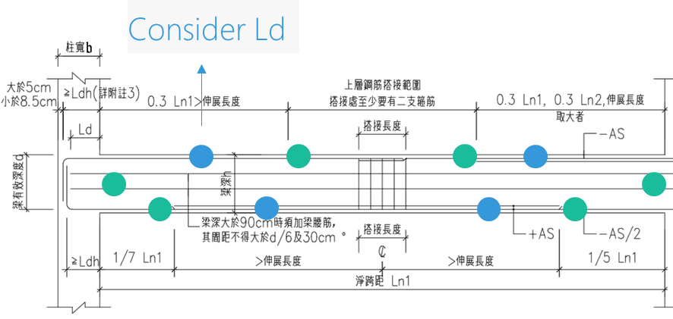
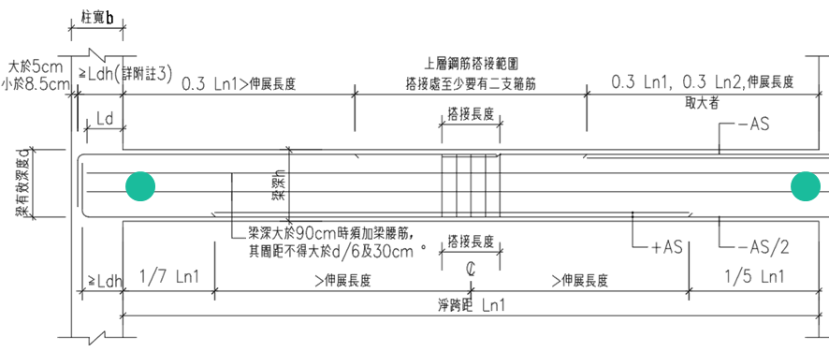
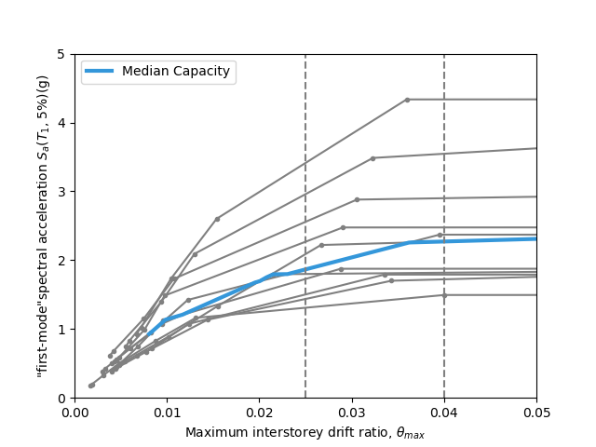


Slide 45


Pushover Load Pattern
Inverted Triangle
Multi-Modes Combination
Modal Pushover Analysis
Mode Shape
Effective Mass
SRSS
Notes:
定義非線性驗證的邊界

Slide 46
Inverted Triangle
Low Seismic 12m
Tradition
Multi-Cut

Slide 47
Multi-Modes Combination
Multi-Cut

Slide 48
Modal Pushover Analysis
Tradition
Mode1
Mode2

Slide 49
Modal Pushover Analysis
Multi-Cut
Mode1
Mode2

Slide 50




Step 3
Step 5
更新圖片
Step 7
Step 8

Slide 51

Time history Analysis
Story Drift
Scaled to DBE, MCE
DBE < 1.5%
MCE < 2%

Slide 52


DBE < 1.5%
Low Seismic 12m
Tradition
Multi-Cut

Slide 53


MCE < 2.0%
Low Seismic 12m
Tradition
Multi-Cut

Slide 54


DBE
更新圖片
MCE

Slide 55


Incremental Dynamic Analysis
Single Static Analysis
➔
Incremental SPO
Single Time History Analysis
➔
Incremental One

Slide 56

Non-Linear SPO
Elastic
➔
Match
Non-Negative
➔
Equal Displacement
Negative
➔
Softening

Slide 57


Limit-State
4% FEMA273
2.5% SEAOC2000

Slide 58


IDA
Low Seismic 12m
Tradition
Multi-Cut

Slide 59


IDA
Low Seismic 12m

Slide 60
93.6%
Middle Seismic 12m
inverted_triangle
Ra=1.51
R=1.69
Ra=1.54
R=1.72

Slide 61
MMC
Mid Multi
mmc
Ra=1.81
R=2.05

Slide 62
Tradition
Ra =
1.5765
R =
1.7719

Slide 63
Multi
Mid Multi
Ra =
1.5498
R =
1.7449

